Slide 1


Session 2 (DAY 2) Statistical Literacy Workshop on Quantitative Literacy and Statistics

Slide 2
Session 2: Part 1 Randomization Workshop on Quantitative Literacy and Statistics

Slide 3
Conclusions
Sampling
Sample
Population
Population
Sample
Collection of “ALL” individuals or items that we are interested in a study
Parameters: function of population data
Subset of population
Statistic: function of sample data
Notes:
The purpose of sampling in research.
Population vs. sample: Why do we sample instead of measuring the entire population?
Definitions of key concepts: Population, sample, parameter, statistic.

Slide 4
Research Problem
Define the Population
Define Parameters of Interest
Apply a Sampling Method
Select a Sample
Evaluate Statistics
Confidence Intervals
Hypothesis Testing
Estimate the Population Parameters

Slide 5
Sampling Bias
Sampling Bias occurs when samples do not accurately represent the population
Selection
Bias
Undercoverage Bias
Voluntary Response Bias
Nonresponse Bias
Notes:
Definition of sampling bias and its effects on research.
How improper sampling leads to biased conclusions.
Examples of sampling bias in real-world studies (e.g., election polls, health studies).

Slide 6

Literary Digest, 1936: Sampling Bias Case Study
Literary Digest conducted a poll predicting the 1936 U.S. presidential election.
Sample size: Over 2 million respondents.
Prediction: Landon would defeat Roosevelt by a landslide
Outcome
Actual result: Roosevelt won 62% to 37%.
Literary Digest's credibility was ruined, leading to its closure in 1938.
Notes:
Definition of sampling bias and its effects on research.
How improper sampling leads to biased conclusions.
Examples of sampling bias in real-world studies (e.g., election polls, health studies).

Slide 7
Literary Digest, 1936: Sampling Bias Case Study
What Went Wrong?
Selection Bias:
Sample collected from telephone directories and automobile registrations.
Overrepresented wealthy individuals were more likely to vote in Landon.
Undercoverage Bias:
Underrepresented lower-income groups, who largely supported Roosevelt.
Nonresponse Bias:
Only 25% of those polled responded, skewing the results further.
Takeaways:
Large samples do not guarantee accuracy if the sample is not representative.
Sampling bias leads to inaccurate statistical estimates and predictions
Ensuring random sampling methods
Notes:
Definition of sampling bias and its effects on research.
How improper sampling leads to biased conclusions.
Examples of sampling bias in real-world studies (e.g., election polls, health studies).

Slide 8
Click for Sampling Bias Demonstration

Slide 9
Random Sampling
Random Sampling
Conclusion
Population
Sample
Notes:
The purpose of sampling in research.
Population vs. sample: Why do we sample instead of measuring the entire population?
Definitions of key concepts: Population, sample, parameter, statistic.

Slide 10

Non-random sampling → Sampling Bias
Non-random sampling
Conclusion
Population
Sample
Notes:
The purpose of sampling in research.
Population vs. sample: Why do we sample instead of measuring the entire population?
Definitions of key concepts: Population, sample, parameter, statistic.

Slide 11



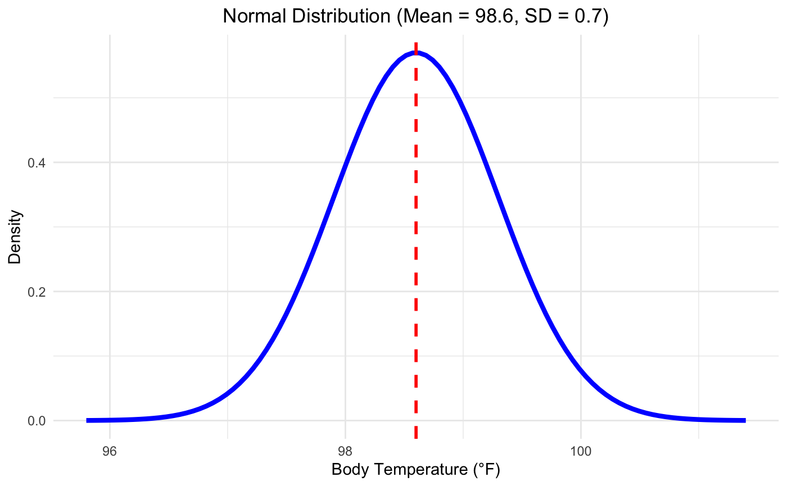
Probability Distribution of Population
Probability Distribution: a mathematical function of the likelihood of occurrence of all possible outcomes in a population
Enable to define population with a few set-up parameters
For example, If the population follows a normal distribution, then the mean and variance of the population are sufficient to extract all information about the population

Slide 12
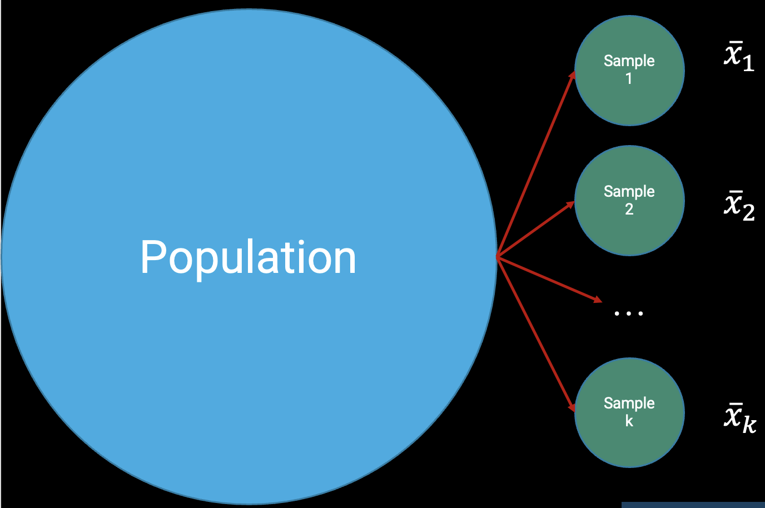
Sampling Distribution
Probability distribution of a statistic
Central Limit Theorem:
For any population, if we have a sufficiently large sample, the sampling distribution of the sample mean follows a Normal Distribution
Demonstration

Slide 13
Random Sampling
Method of selecting a subset of individuals or items from a Population
Probability of selection can be computed

Slide 14


Simple Random Sampling
Stratified Sampling
Each member of the population has an equal and independent chance of being selected.
The population is divided into subgroups based on specific characteristics (e.g., age, gender), and random samples are taken from each stratum.
Cluster Sampling
Systematic Sampling
The population is divided into clusters (e.g., based on geographical areas), and entire clusters are randomly selected.
In this method, the first sample is selected randomly, and then subsequent samples are selected at regular intervals

Slide 15
Simple Random Sampling
Each member of the population has an equal and independent chance of being selected.

Slide 16
Stratified Sampling
The population is divided into subgroups based on specific characteristics
(e.g., age, gender), and random samples are taken from each stratum.

Slide 17
Cluster Sampling
The population is divided into clusters
(e.g., based on geographical areas), and entire clusters are randomly selected.

Slide 18
Systematic Sampling
In this method, the first sample is selected randomly, and then subsequent samples are selected at regular intervals

Slide 19
Elimination of Sampling Bias
Apply proper RANDOM SAMPLING techniques
In the Experimental Designs, randomly assigned items/subjects for treatments and control groups
For Observed Data sets, perform Permutation tests and Bootstrap tests
Notes:
Definition of sampling bias and its effects on research.
How improper sampling leads to biased conclusions.
Examples of sampling bias in real-world studies (e.g., election polls, health studies).

Slide 20
Session 2: Part 2 P-value, Confidence Intervals, and Power Workshop on Quantitative Literacy and Statistics

Slide 21


Hypothesis Test
Making Claims about the Population Parameters
$H_{0}$ Null Hypothesis
$H_{1}$Alternative Hypothesis

Slide 22
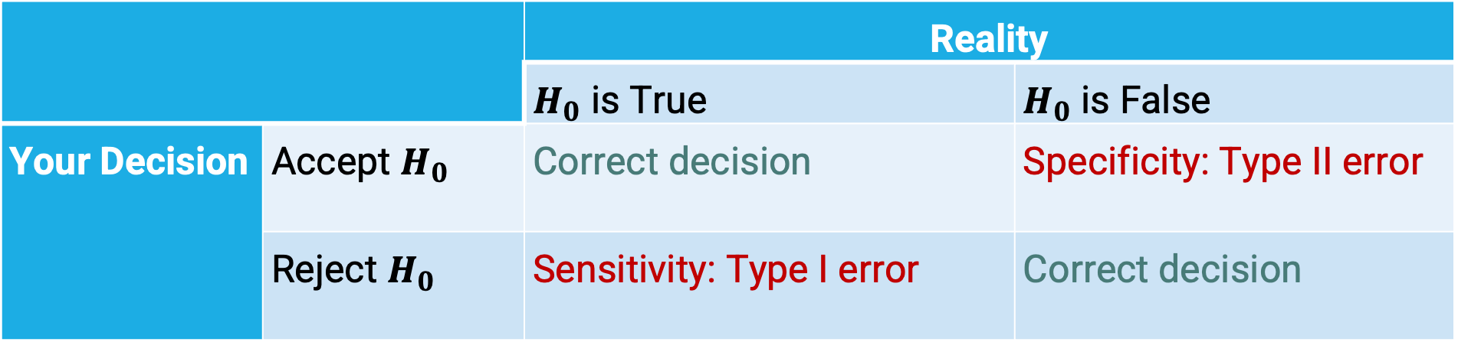
Errors in Hypothesis Testing
 |  | Reality
 |  | $H_{0}$ is True | $H_{0}$ is False
Your Decision | Accept $H_{0}$ | Correct decision | Specificity: Type II error
 | Reject $H_{0}$ | Sensitivity: Type I error | Correct decision

Slide 23
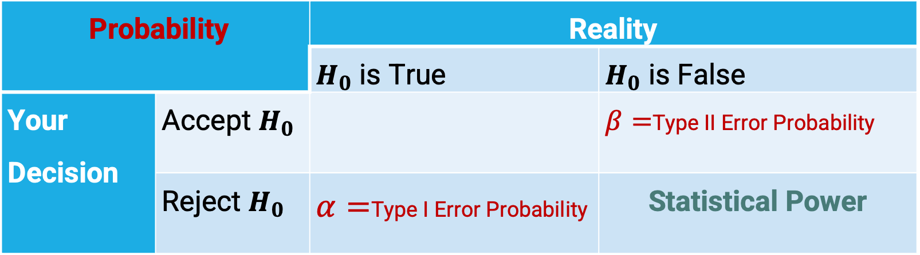
Errors in Hypothesis Testing
Probability |  | Reality
 |  | $H_{0}$ is True | $H_{0}$ is False
Your Decision | Accept $H_{0}$ |  | $β=$Type II Error Probability
 | Reject $H_{0}$ | $α=$Type I Error Probability | Statistical Power
Statistical Power
Probability of Rejecting Null Hypothesis When It False

Slide 24
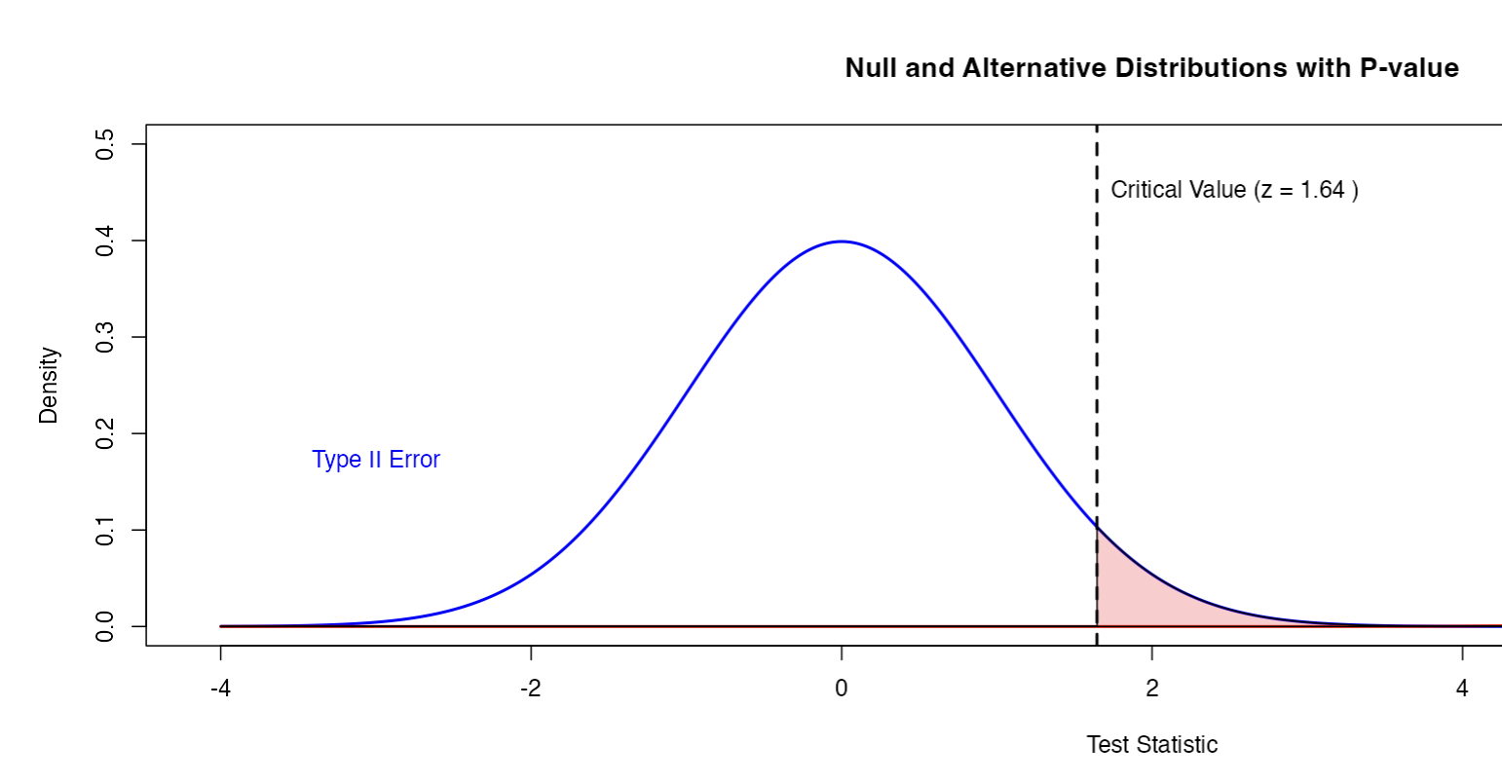
Distribution under Null
Distribution under Null
Type 1 Error

Slide 25
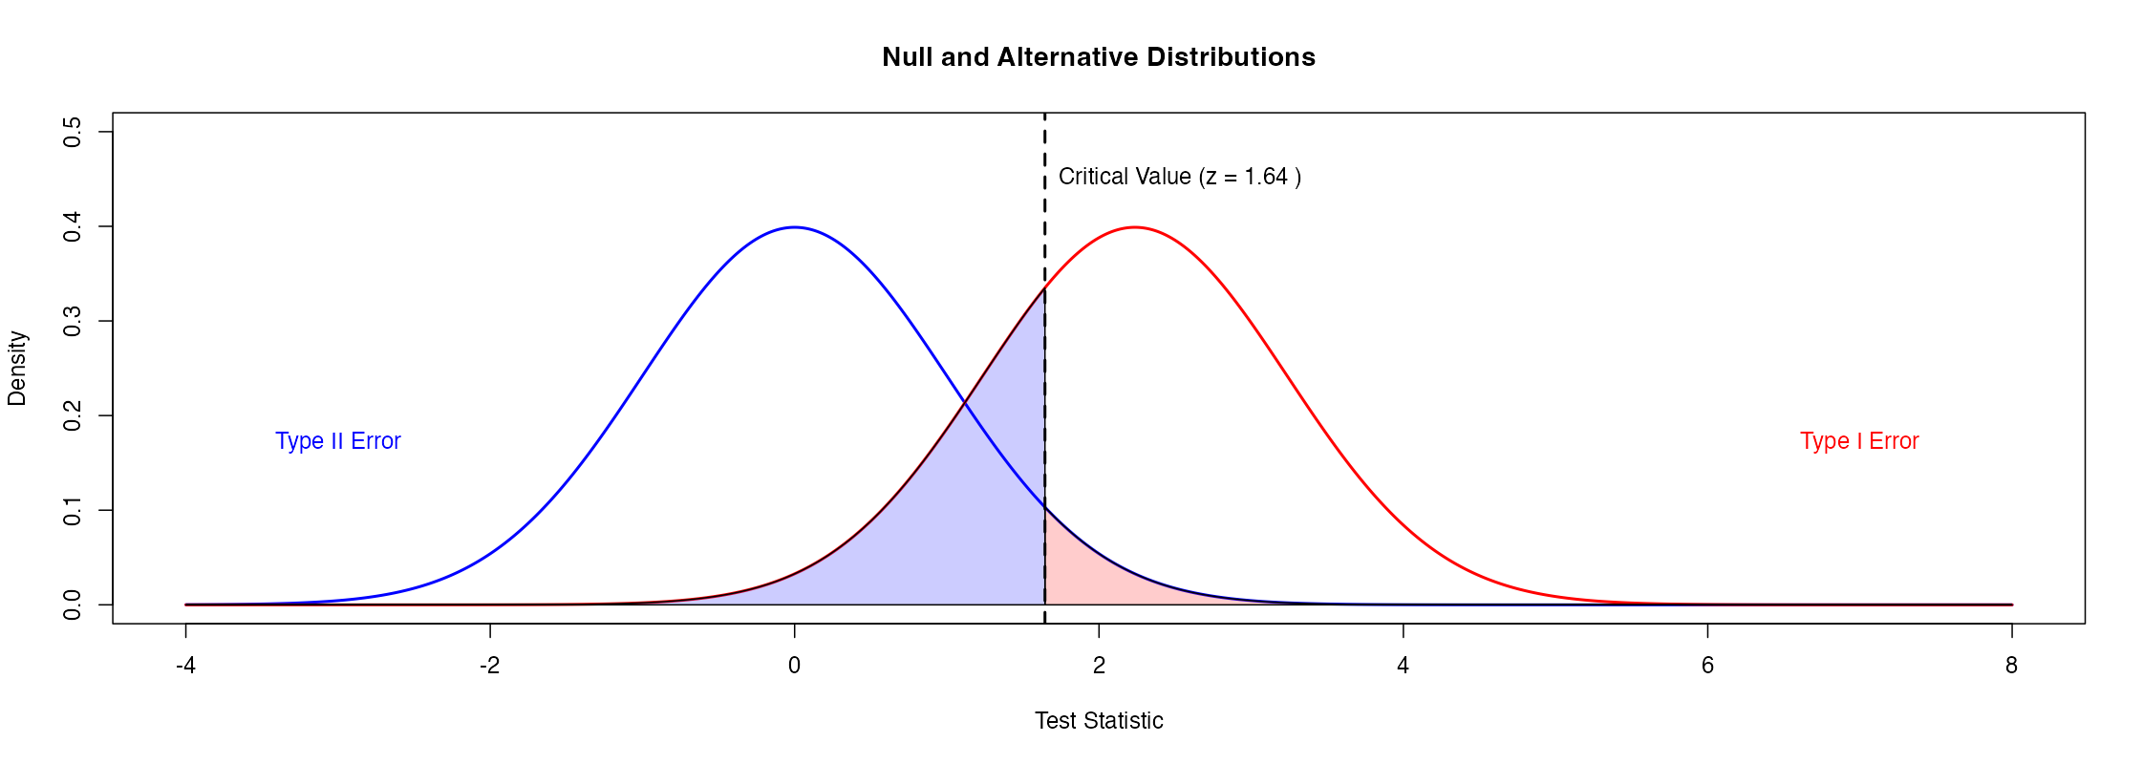
Distribution under Null
Distribution under Alternative

Slide 26
Distribution under Null
Distribution under Alternative
Power

Slide 27
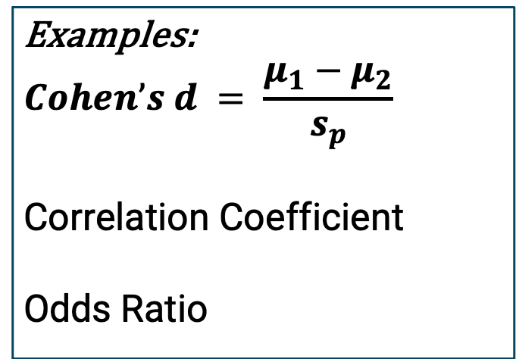
Effect Size
Magnitude difference between variables or groups
Examples:
$$Cohen’s d = \frac{μ_{1}−μ_{2}}{s_{p}}$$
Correlation Coefficient
Odds Ratio

Slide 28
Distribution under Null
Distribution under Alternative
Effect Size

Slide 29
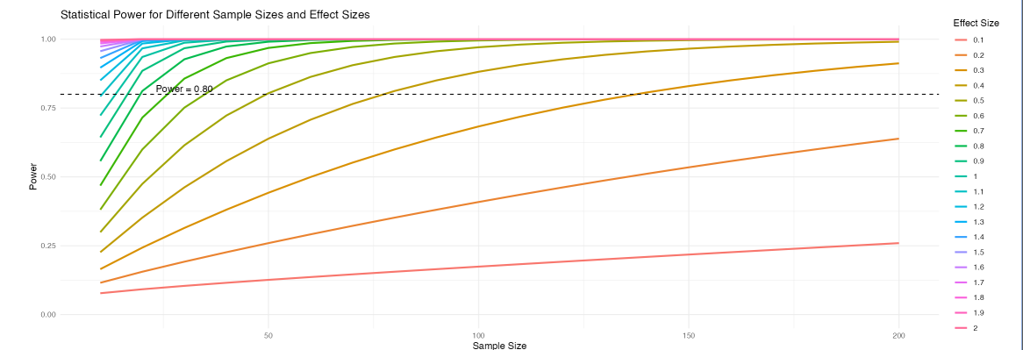
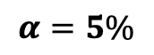
Statistical Power vs.
Effect Size and Sample Size
$$α=5\%$$
Factors that affect Statistical Power:
Effect size (the magnitude of the difference between groups)
Sample size (larger samples increase power)
Significance level (α) (lower α reduces power)
Variability in the data (lower variability increases power)
Sufficient sample size shall be evaluated using statistical power

Slide 30
Click for Statistical Power Demonstration

Slide 31
P-Value
A probability
$H_{0}$ is true
𝑯_𝟎 is true
Test Statistic is Extreme than the Observed
Important
Indicates how incompatible the data are with a specific statistical model
The p-value does not measure the size of the effect or the importance of the results
Larger p-value value does not indicate that evidence in favor of the null hypothesis

Slide 32
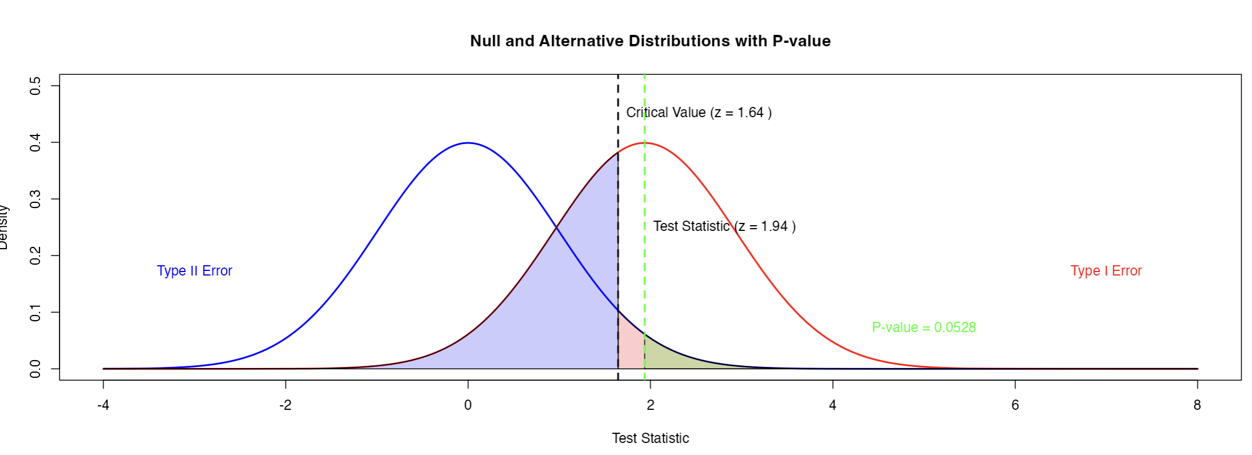

Slide 33

Confidence Interval
Range of plausible values for a population parameter based on the sample data
$$Point Estimate ± Margin of Error$$
A 95% confidence interval means that if you repeated the experiment many times, 95% of the confidence intervals would contain the true population parameter.
Example:
Suppose for an experiment, the confidence interval for body temperature is evaluated as [98.4, 98.8]
This interval implies if you repeated the experiment many times, 95% of the confidence intervals would contain the true body temperature of 98.6.

Slide 34
Confidence Interval
Range of plausible values for a population parameter based on the sample data
$$Point Estimate ± Margin of Error$$
Important
CI is not the probability of parameter of the parameter in the interval
CI width indicates the precision of the estimate
Larger sample size, small standard deviation, and lower confidence levels reduce the width of the confidence intervals

Slide 35
Click for Confidence Interval Simulator

Slide 36
Confidence Intervals vs. P-value
Confidence Interval | P-value
Range of possible values for population parameter | Probability of observed data are extreme compared to null hypothesis
More information about effect size | Use for Decision-making or test Statistical Significance: reject or failed to reject the null hypothesis
Precision in CI provides a better indication of the uncertainty
Better alternative to p-value

Slide 37
Click for Confidence Interval vs. P-value Simulator

Slide 38
Key Takeaways
Utilize random sampling and randomized experiments to minimize sampling bias.
Compute the sample size by considering the statistical power and effect size of the test.
Report the p-value and confidence intervals and incorporate both in the decision-making process.
Thank you!

